Slide 1
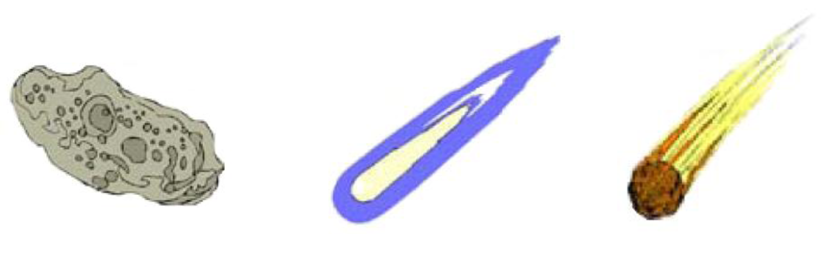
Comets, Meteors, and Asteroids in the Solar System

Slide 2
Essential Question:
What is the difference between a comet, meteor, and asteroid?
Standard S6E1f. Describe the characteristics of comets, asteroids, and meteors.
Notes:
Instructional Approach(s): The teacher should introduce the essential question and the standard that aligns to the essential question.

Slide 3
Use the graphic organizer to record important information.
Notes:
Instructional Approach(s): The teacher should give each student a copy of the graphic organizer to record important information during the lesson.

Slide 4
Comets

Slide 5
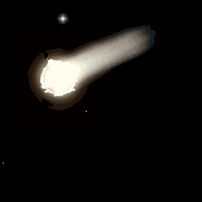

Slide 6
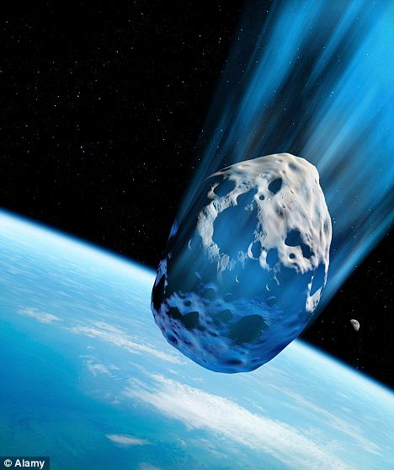
Comets
Comets are composed of dust and rock mixed with frozen water, methane, and ammonia
Comets are considered to be like a large, dirty snowball
Notes:
Instructional Approach(s): The teacher should present the characteristics of a comet while the students record the important information on their notes.

Slide 7
Comets
Comets travel around the sun in elliptical orbits
Notes:
Instructional Approach(s): The teacher should present the characteristic of a comet while the students record the information on their notes. The teacher should show the animation of a comet traveling in the solar system to reinforce the concepts.

Slide 8
Comets
When a comet nears the sun, some of it melts and forms a long tail (gases in the comet are vaporized by the sun)
When a comet moves farther away from the sun, the tail disappears
Notes:
Instructional Approach(s): The teacher should present the characteristics of a comet while the students record the information on their notes. The teacher should show the animations of a comet traveling in the solar system to reinforce the concepts.

Slide 9
After a comet has passed close to the Sun many times, it breaks apart. The small pieces from the comet spread out.
These pieces of dust and rock, along with those coming from other sources, are called Meteoroids.
Notes:
Instructional Approach(s): The teacher should present the information on the slide.

Slide 10
Meteoroid, Meteor, Meteorite?
The difference is just based on where the rock is located when you are describing it.
Notes:
Instructional Approach(s): The teacher should present the information on the slide.

Slide 11

Meteoroid is a “space rock” that is still in space
Meteor is a meteoroid that burns up in the earth’s atmosphere
(Shooting Star)
Meteorite is a meteoroid that hits
the earth’s surface
Notes:
Instructional Approach(s): The teacher should present the information on the slide while the students record the important information on their notes. Possibly do the Meteor Burnout demonstration linked on the resource page.

Slide 12
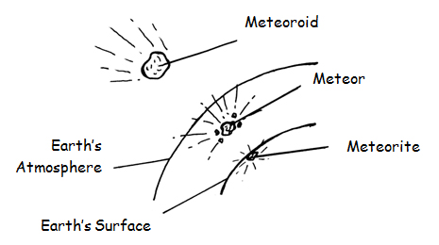
Notes:
Instructional Approach(s): The teacher should use the image on the slide to reinforce the difference between a meteoroid, meteor, and meteorite.

Slide 13
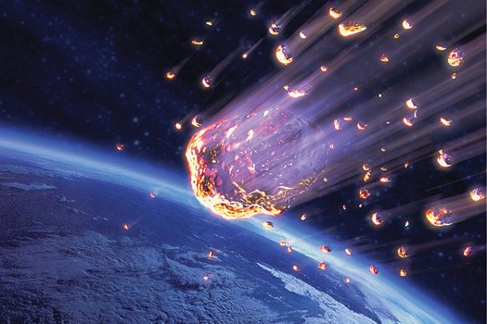
Meteor
Notes:
Instructional Approach(s): The teacher should present the information on the slide while the students record any important information on their notes.

Slide 14
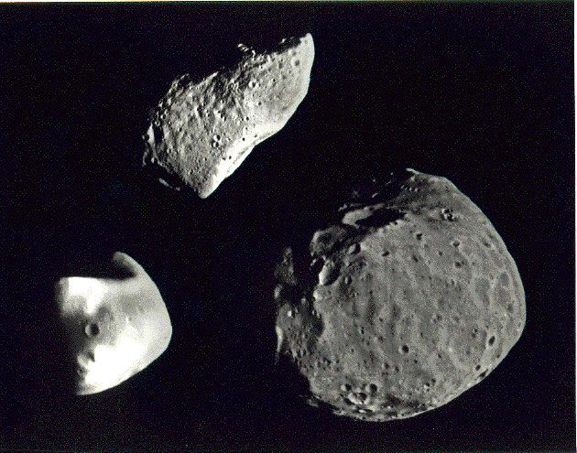
Asteroids
Notes:
Instructional Approach(s): Introduce Asteroids

Slide 15
Asteroid
A piece of rock similar to the material formed into planets.
An Asteroid is smaller than a
planet but larger than a meteoroid
Notes:
Instructional Approach(s): The teacher should present the characteristics of an asteroid while the students record important information on their notes.

Slide 16
Asteroid
Most asteroids are located in an area between the orbits of Mars and Jupiter called the Asteroid Belt.
Notes:
Instructional Approach(s): The teacher should present the characteristics of an asteroid while the students record important information on their notes.

Slide 17
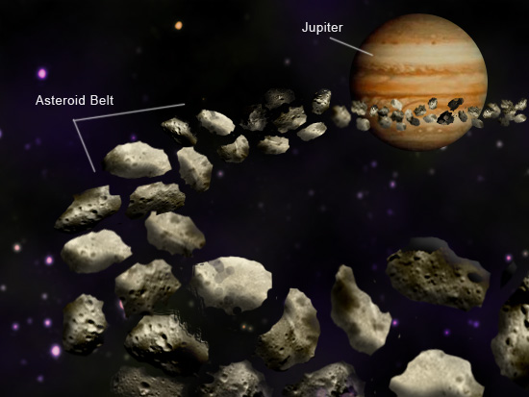
Notes:
Instructional Approach(s): The teacher should use the image to reinforce the location of asteroids.

Slide 18
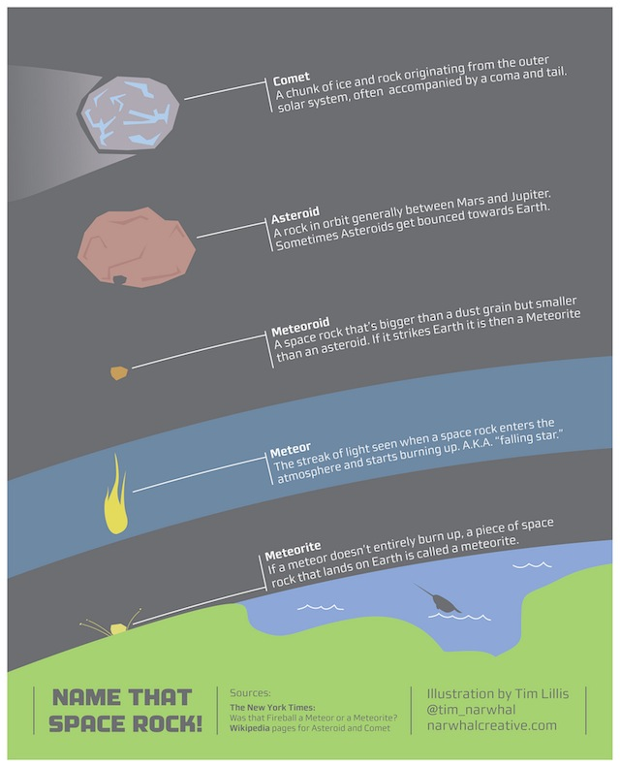
Notes:
Instructional Approach(s): The teacher should use the image to reinforce the characteristics of a comet, asteroid, and a meteor.

Slide 19
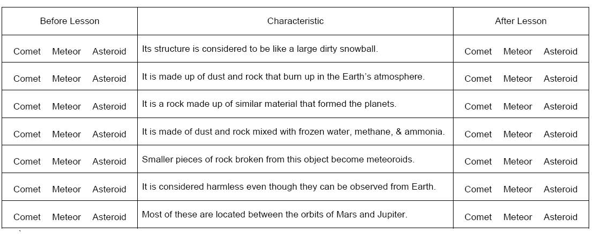
Summarizing Strategy
Complete the “After the Lesson” section of the Comets, Meteors, and Asteroids Anticipation Guide by selecting which object each statement describes.

Slide 20
teacher check
Notes:
Instructional Approach(s): The teacher should use the slide to go over the information ONLY AFTER the teacher has viewed student responses to determine student mastery of the concepts.

Slide 21
Notes:
Instructional Approach(s): The teacher should use the slide to allow students to make sure they have the correct information in their graphic organizer.

